Slide 1
Capstone Project Unit Management System
Group 14 – Yoon, Sean, Seyoung and Yeongje

Slide 2





Project Overview
IFB398/399 Capstone
Major Group Projects
Stakeholders

Slide 3
Problems with the current system
Very inefficient and difficult to navigate
Forming and Managing Groups – BlackBoard, Excel
Project allocation and ranking – Google forms
Submitting Assessments – Inplace, Google forms and etc..
Managing presentations and fortnight meetings –BlackBoard

Slide 4
Project Goals
Develop a comprehensive and optimised web based service
The website will work alongside with Blackboard and replace google forms, Inplace and Microsoft Excel
Better accessibility and navigability
Make Capstone a better unit

Slide 5
Technical Requirements
User Authentication – Sign up and sign in
Form groups – Manually and automatically
Propose and apply for projects
Assign Project to teams automatically by ranking
Time slot allocation for tutor meetings/Presentations
Upload Assessments/CVs
Release Marks

Slide 6
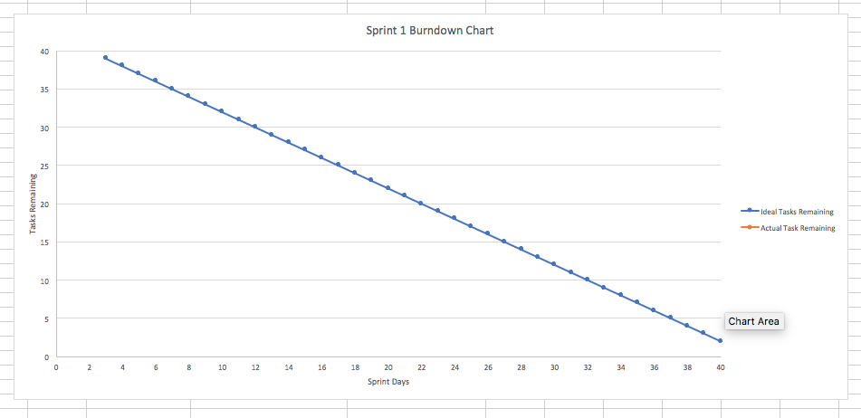
Project feasibility

Slide 7
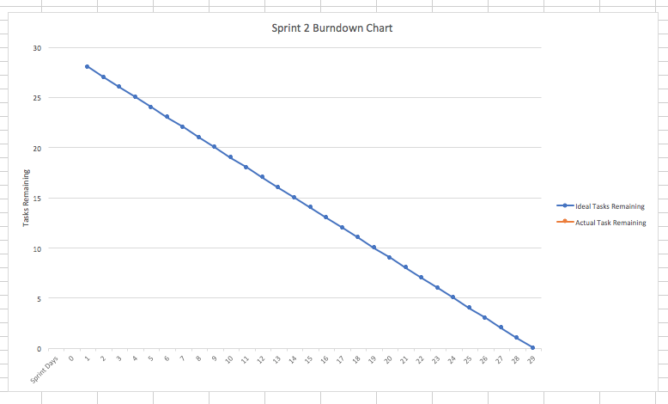

Slide 8
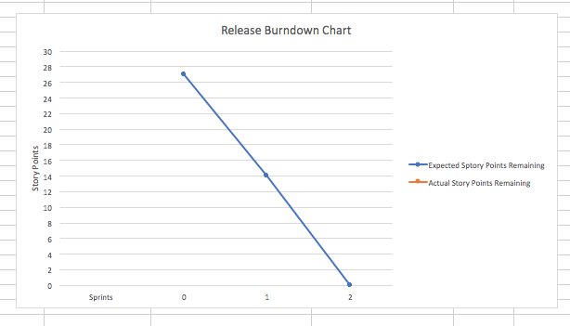

Slide 9
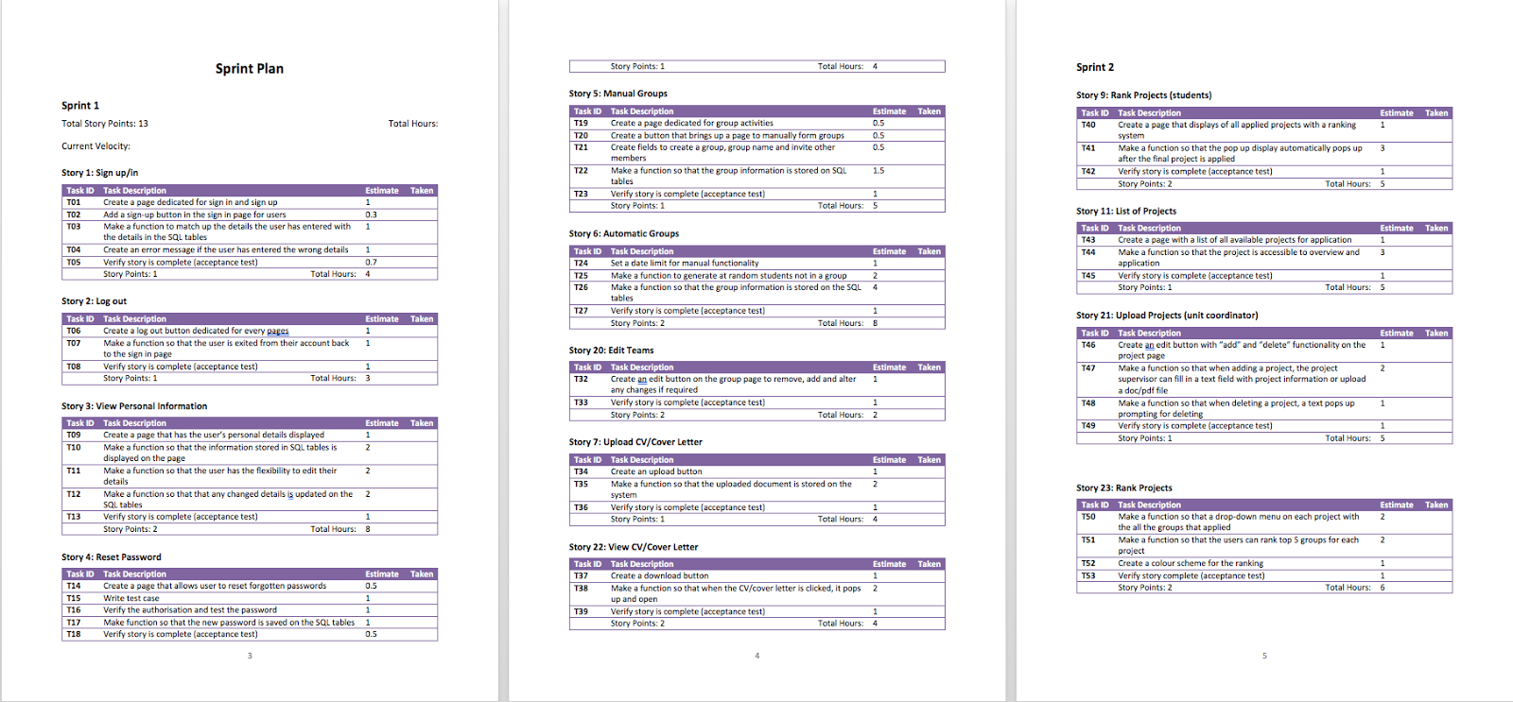
Project Plan

Slide 10
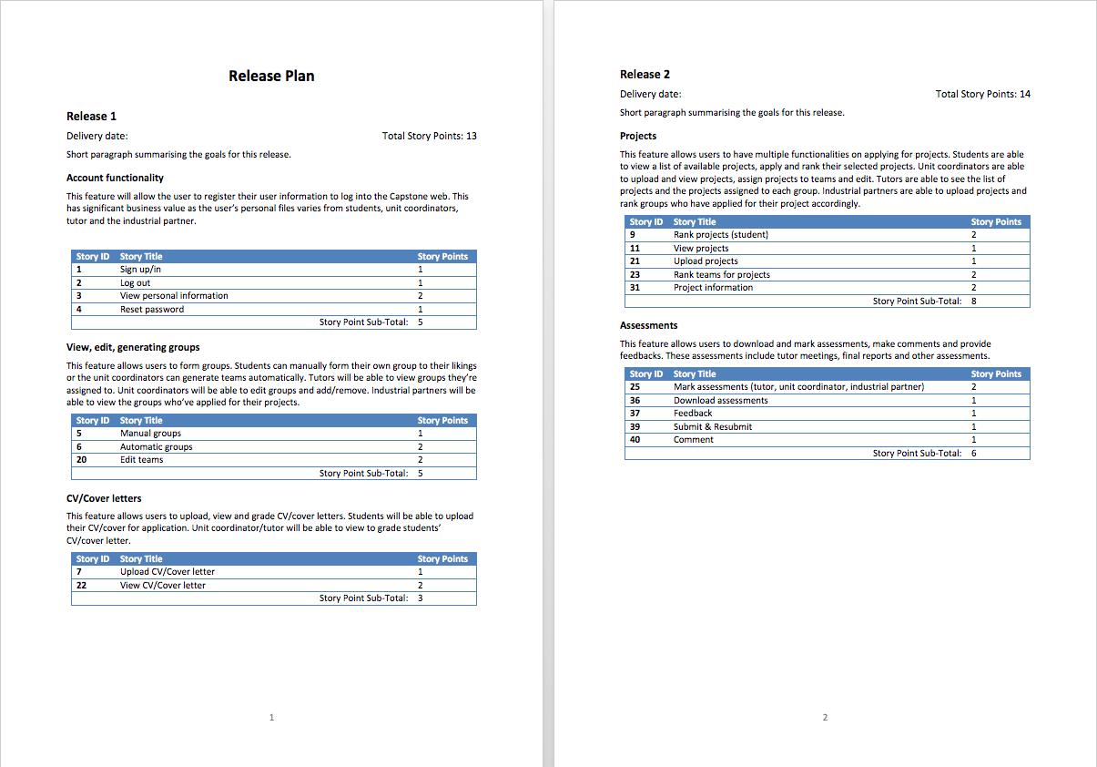

Slide 11
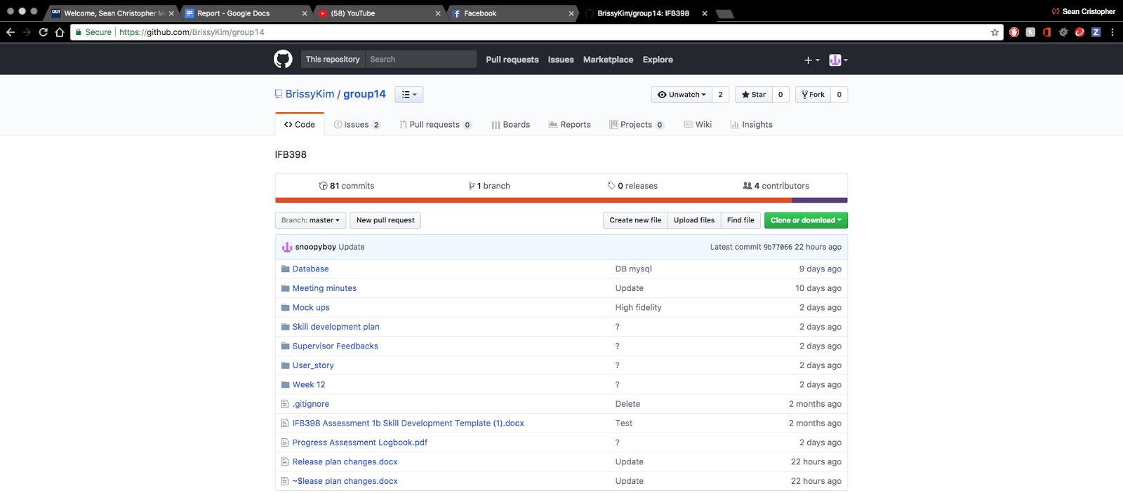
Project management

Slide 12
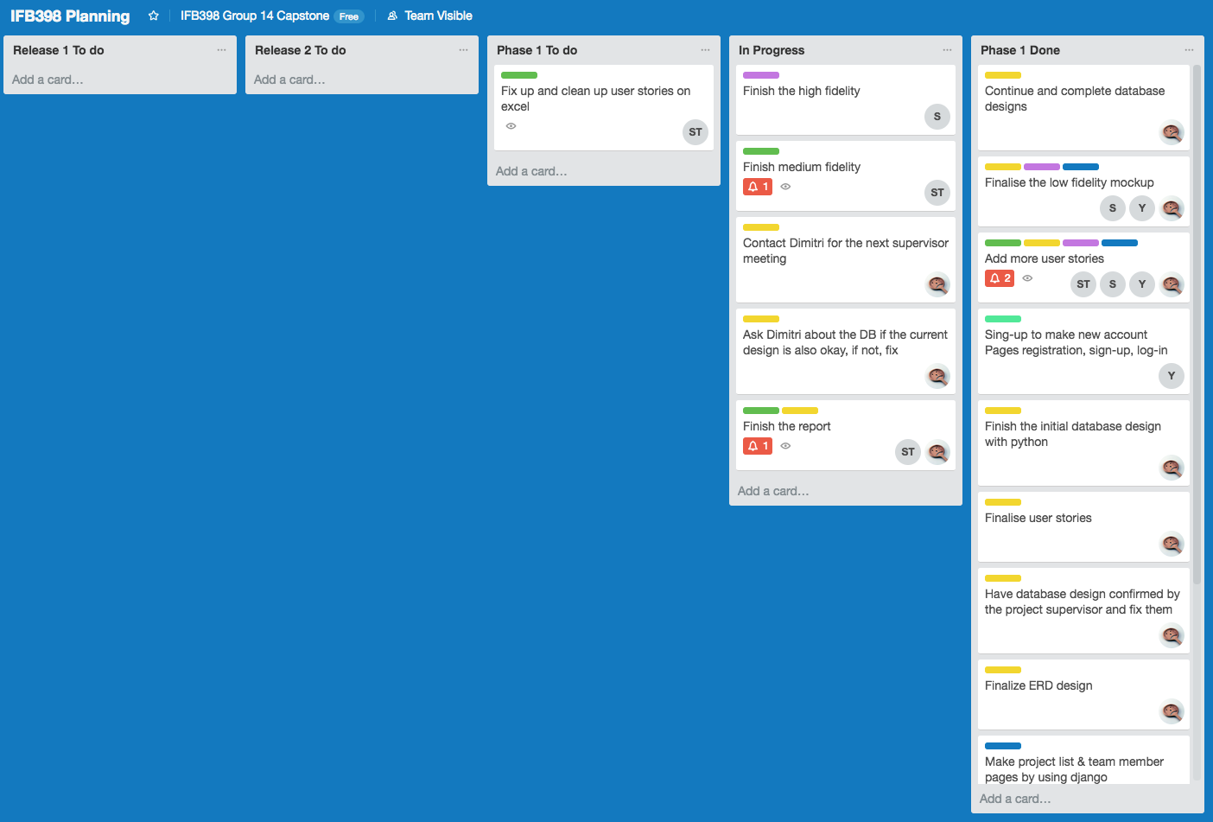

Slide 13
Project Design
Why python and Django?
Database Design
Low/Med/High Fidelity

Slide 14
Why python and Django?
PYTHON AND DJANGO ARE HUGE IN FINTECH
IT HAS A TON OF RESOURCES
DJANGO, A HIGH-LEVEL PYTHON WEB FRAMEWORK, IS FLAT-OUT AMAZING

Slide 15
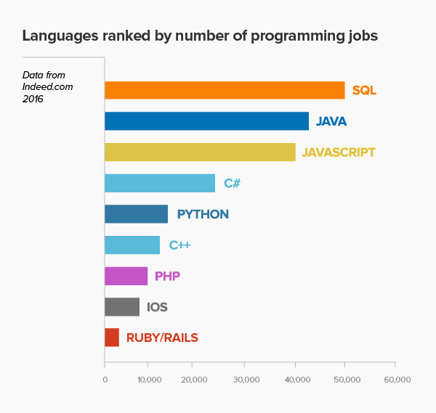
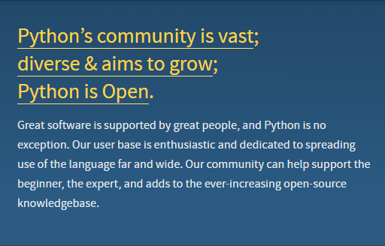
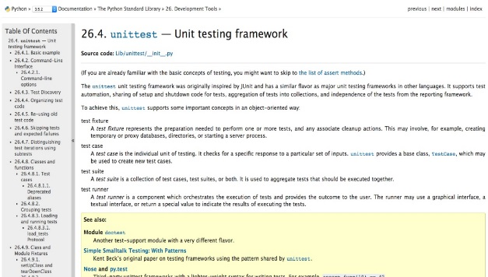
Huge COMMUNITY AND A TON OF RESOURCES

Slide 16
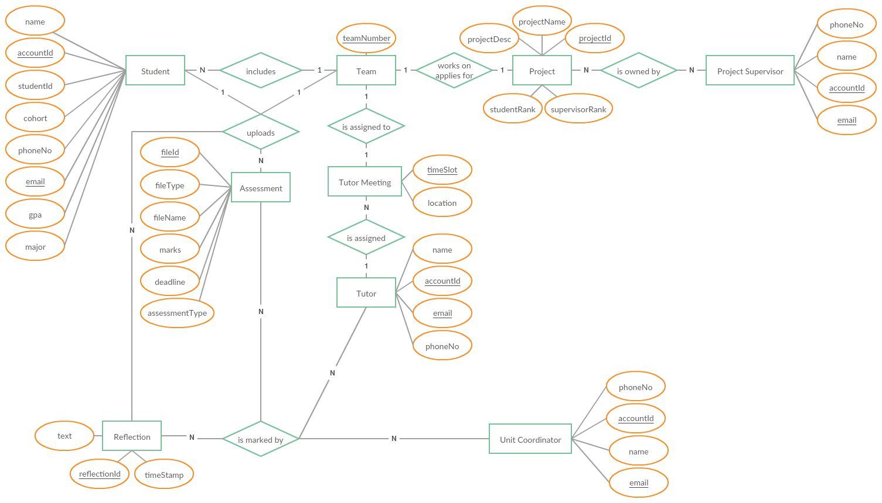
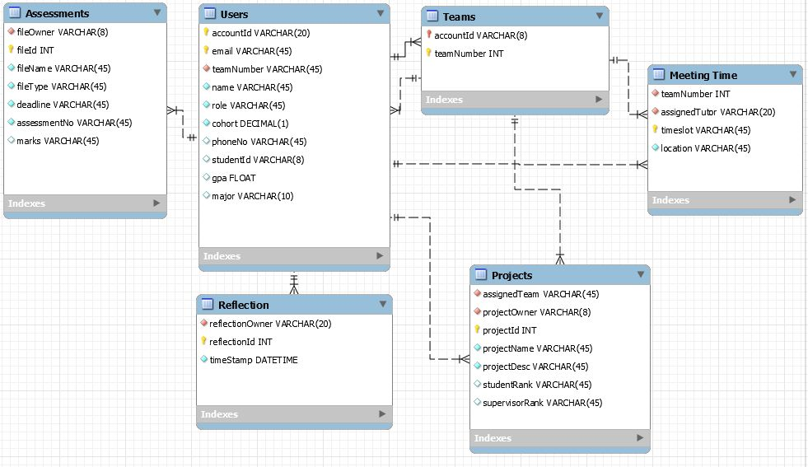
Database Design
Entity Relationship Diagram
Database Tables

Slide 17
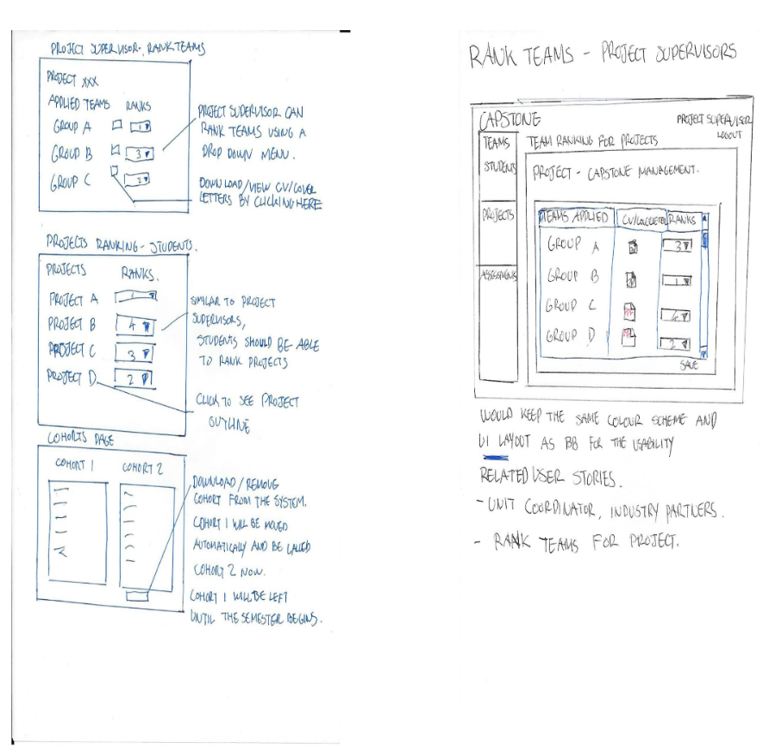
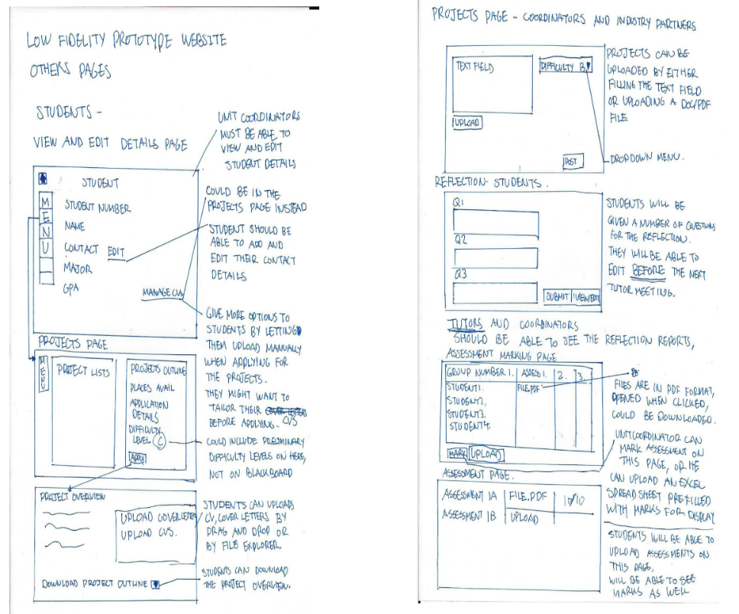
Low Fidelity Prototype

Slide 18
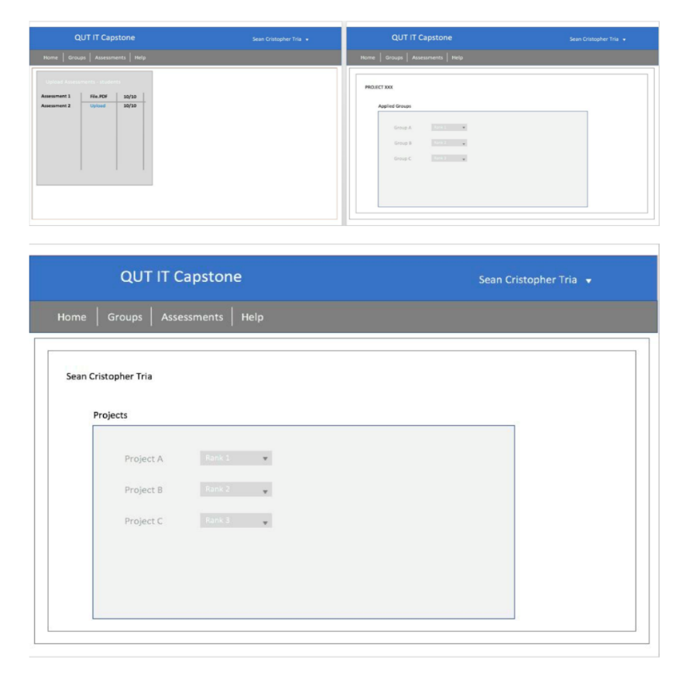
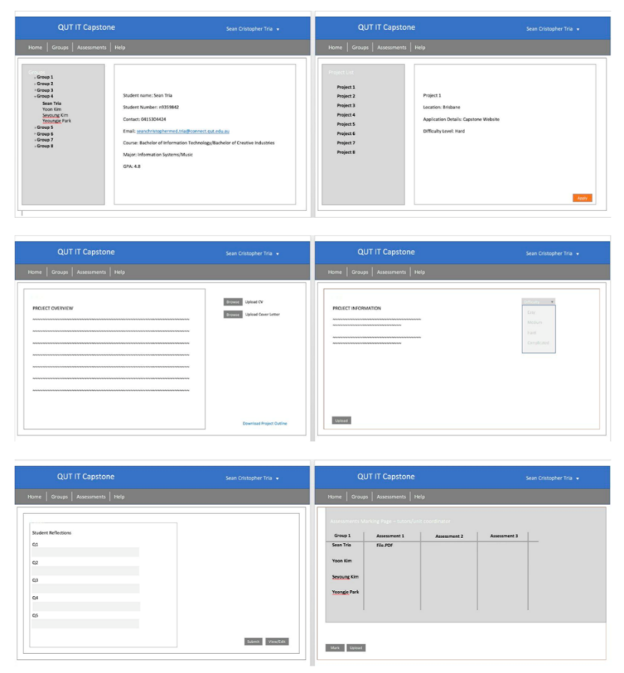
Medium Fidelity Prototype

Slide 19
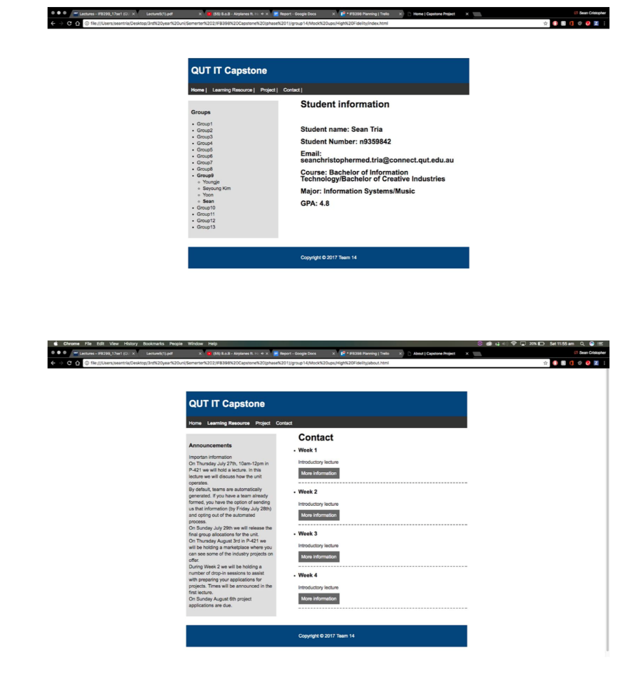
High Fidelity Prototype

Slide 20
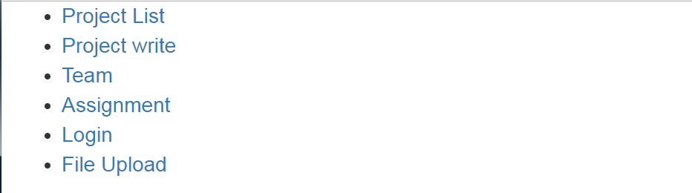
Initial Work and Prototype for web application (Functional prototype pages)
- First page

Slide 21
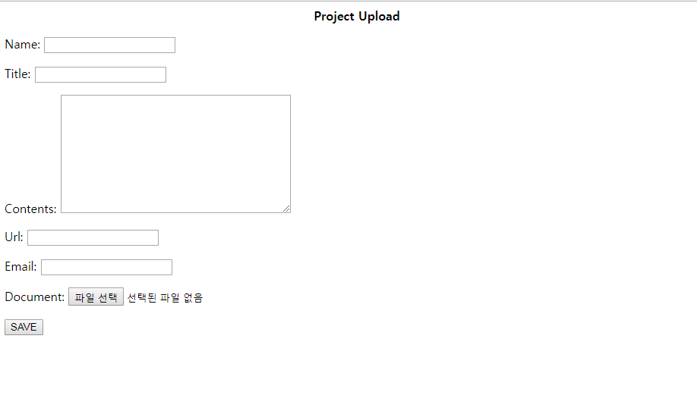
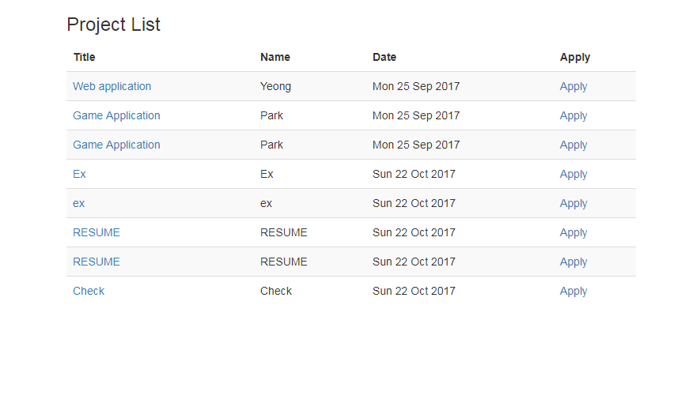
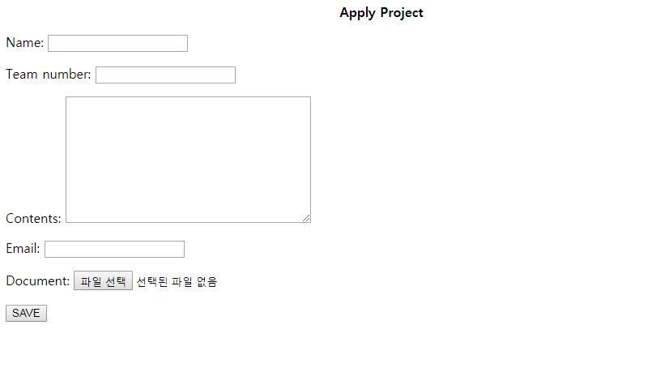
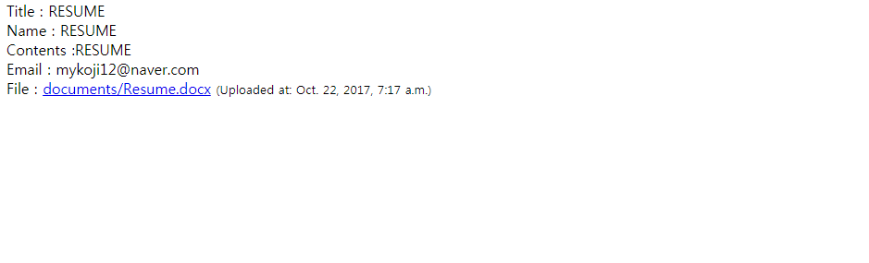
Project pages
Project Detail

Slide 22
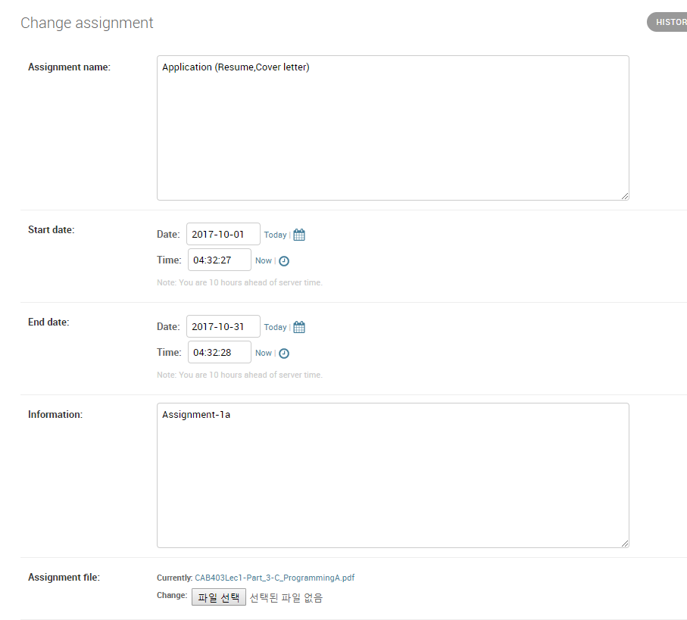
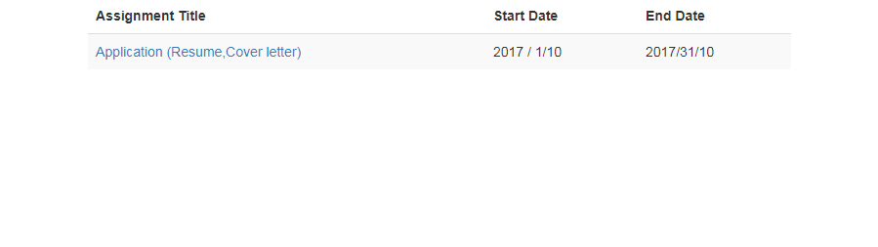
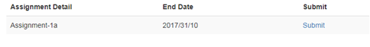
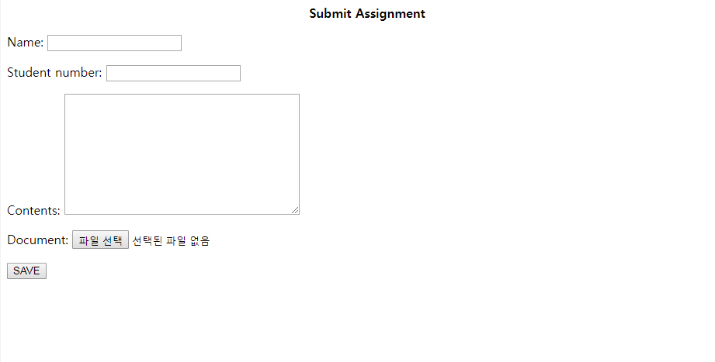
Assignment pages
Assignment List

Slide 23
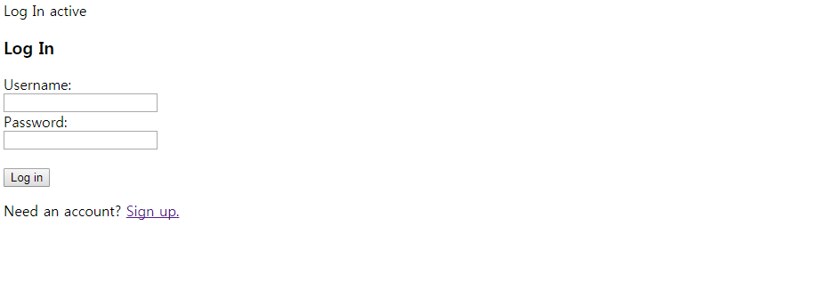
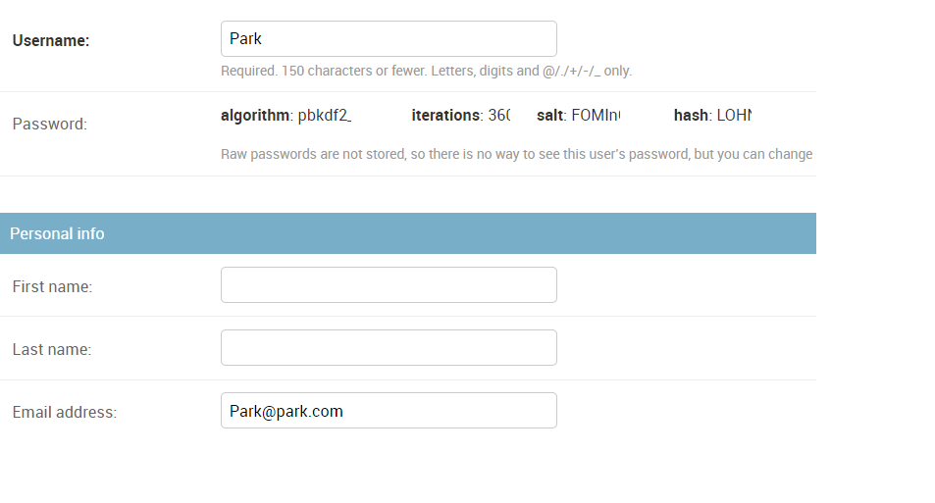
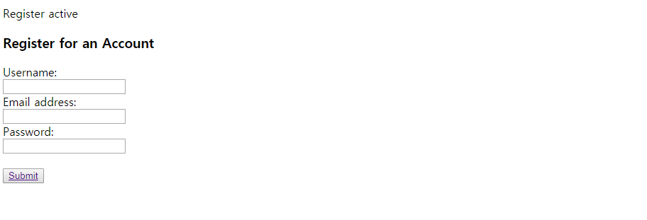
Log-in & Sign-up pages

